Slide 1


API Management with Microservices
Sept 14, 2016
@VinayBhalerao

Slide 2
What I am talking about
Microservices: Introduction and Challenges
The Role of API Management in Microservice Architecture
Best practices and use of API Gateway for Microservices

Slide 3
Microservices Architecture

Slide 4


How Microservices?
Crusty Monolith
Awesome Microservices

Slide 5

Known quality for Dev and Ops
Develop → Deploy → Scale → Manage

Slide 6






New Frontier for Dev and Ops
Develop
→ Deploy
→ Scale
→ Manage
Develop
→ Deploy
→ Scale
→ Manage
Develop
→ Deploy
→ Scale
→ Manage
Develop
→ Deploy
→ Scale
→ Manage
Develop
→ Deploy
→ Scale
→ Manage
Develop
→ Deploy
→ Scale
→ Manage

Slide 7
Oh Yeah … It’s Distributed Too
Awesome Microservices

Slide 8
Challenges
How do you determine who get access to the microservice?
Degree to which they have access to the microservice
Discovering and exposing the versioned microservice
Gateway
Managing the API Gateway with zero downtime

Slide 9

What Hope?

Slide 10
The ‘Mantra’
API Management
API
API
API
API
API
API
Develop
Deploy
Scale
Manage
Container Application Platform (PaaS)

Slide 11
The Inner and the Outer Architecture
Src: Gary Olliffe. http://blogs.gartner.com/gary-olliffe/2015/01/30/microservices-guts-on-the-outside/
Notes:
Manfred

Slide 12
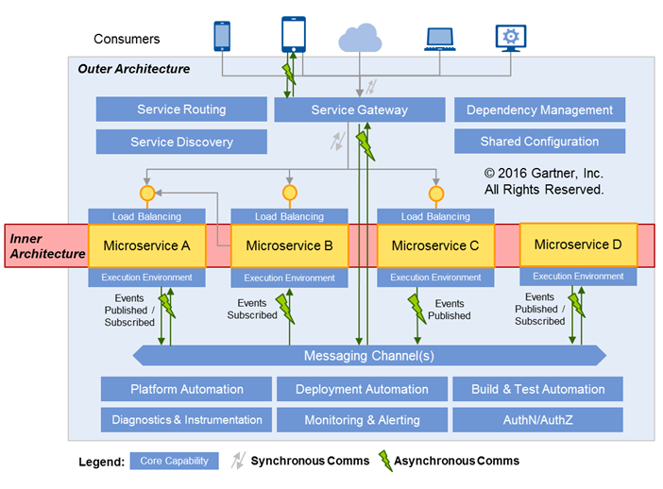
Src: Gary Olliffe. http://blogs.gartner.com/gary-olliffe/2015/01/30/microservices-guts-on-the-outside/
Notes:
Manfred

Slide 13
Src: Gary Olliffe. http://blogs.gartner.com/gary-olliffe/2015/01/30/microservices-guts-on-the-outside/
Notes:
Manfred

Slide 14
Src: Gary Olliffe. http://blogs.gartner.com/gary-olliffe/2015/01/30/microservices-guts-on-the-outside/
Notes:
Manfred

Slide 15
Key Aspects of the Outer Architecture
The Outer Architecture delivers the platform capabilities you need to help all those simple little microservices (and their DevOps teams) work together to make good on the promises of flexible and scalable development and deployment.
It is coping with this complexity that makes SDLC discipline and automation an essential element of delivering microservice architecture.
-- Gary Olliffe
Notes:
Manfred

Slide 16
The Role of API Management in Microservice Architectures
Notes:
Manfred

Slide 17
Typical Use of API Gateways in MSAs
Notes:
Manfred

Slide 18
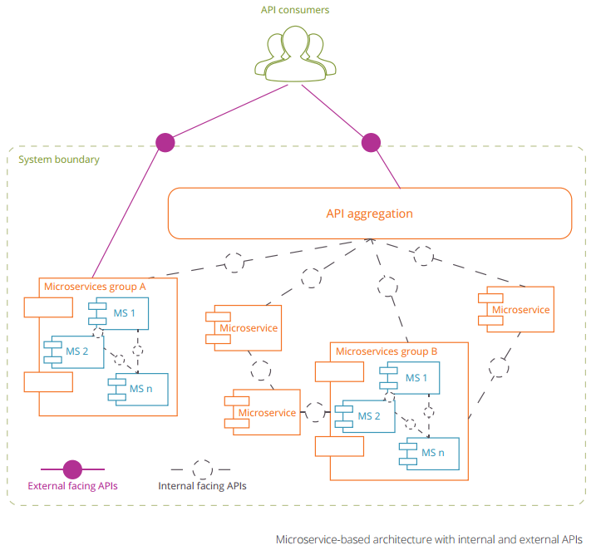
Notes:
Manfred

Slide 19
Notes:
Manfred

Slide 20
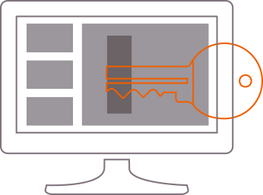
API Management Key Benefits for MSAs 1/5
Fine-grained and flexible access control to microservices
Standard API keys
Application ID and key pair
OAuth v1.0 and 2.0
Notes:
Manfred

Slide 21
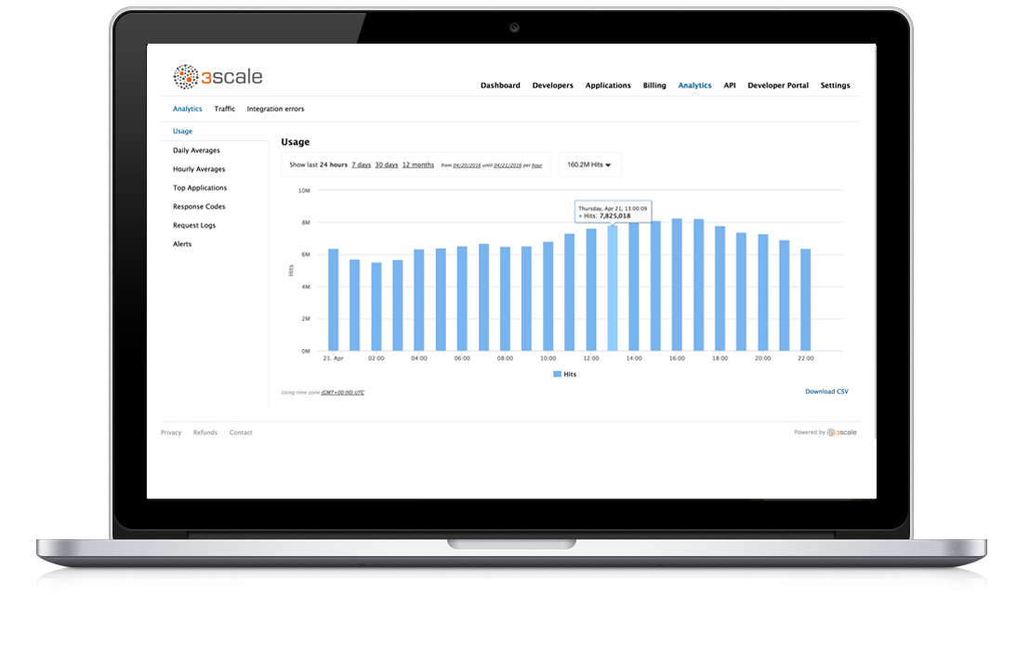
API Management Key Benefits for MSAs 2/5
Microservices usage analytics
Traffic patterns
Top microservice consumers
Alerts, reporting
Notes:
Manfred

Slide 22
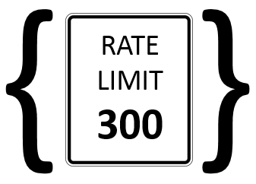
API Management Key Benefits for MSAs 3/5
Configuration of usage contracts such as rate limits
Different microservice consumer segments
Flexible per-time-period limits
Notes:
Manfred

Slide 23
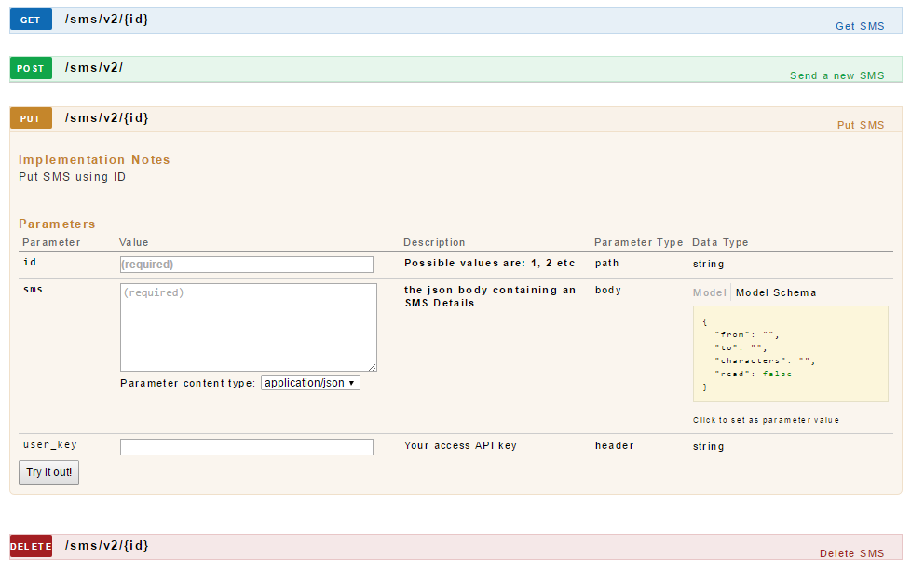
API Management Key Benefits for MSAs 4/5
Automatic and interactive interface documentation
Interactive API documentation
Swagger-based
Self-service developer portal
Notes:
Manfred

Slide 24

API Management Key Benefits for MSAs 5/5
Monetization of individual microservices
Build business model
Flexible pricing rules
Automatic invoicing
Notes:
Manfred

Slide 25
Managing Internal vs External APIs
Along all the 5 key benefits:
Access control and security
Usage analytics
Usage contracts
Documentation
Monetization
Notes:
Manfred

Slide 26
How 3scale handles Gateway with zero downtime
Microservice
GET /productdetails/{id}
API Gateway: eg: Nginx
Static files - API management business logic
Dynamic files - Endpoints information
Command/Script
nginx -s reload

Slide 27
Summary
Notes:
Keith

Slide 28
Key Take-aways
The outer architecture is the environment where the microservices live.
Specifically address the outer architecture to achieve real enterprise agility.
PaaS and API management are two crucial elements of the outer architecture.
API Management allows to define microservice access control, analytics, usage contracts, documentation, or monetization.
Notes:
Keith

Slide 29
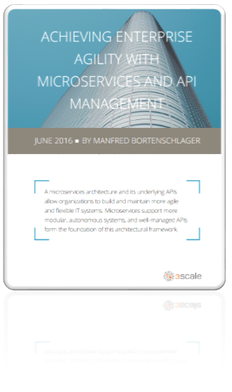
Learn more about API management and microservices
Download the whitepaper:
http://bit.ly/APIsforMSA
Contact us:
support@3scale.net
Notes:
Keith

Slide 30
-- The End --

